Slide 1
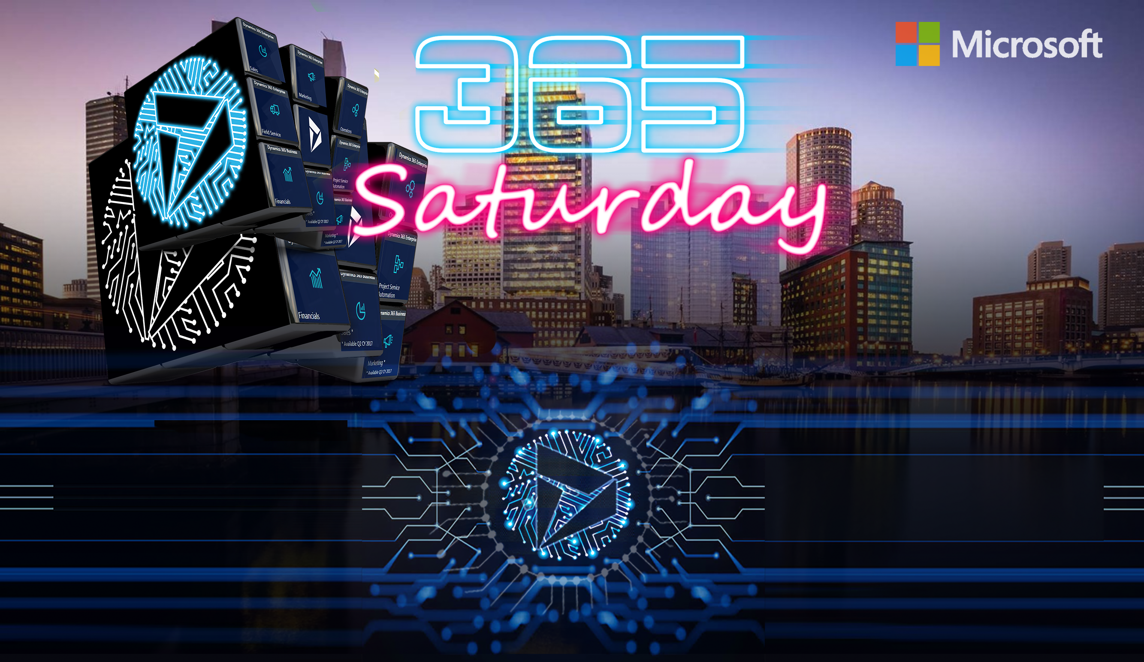
Michael Ochs, MVP
Aiden Kaskela, MVP
Bots Are the New Apps

Slide 2
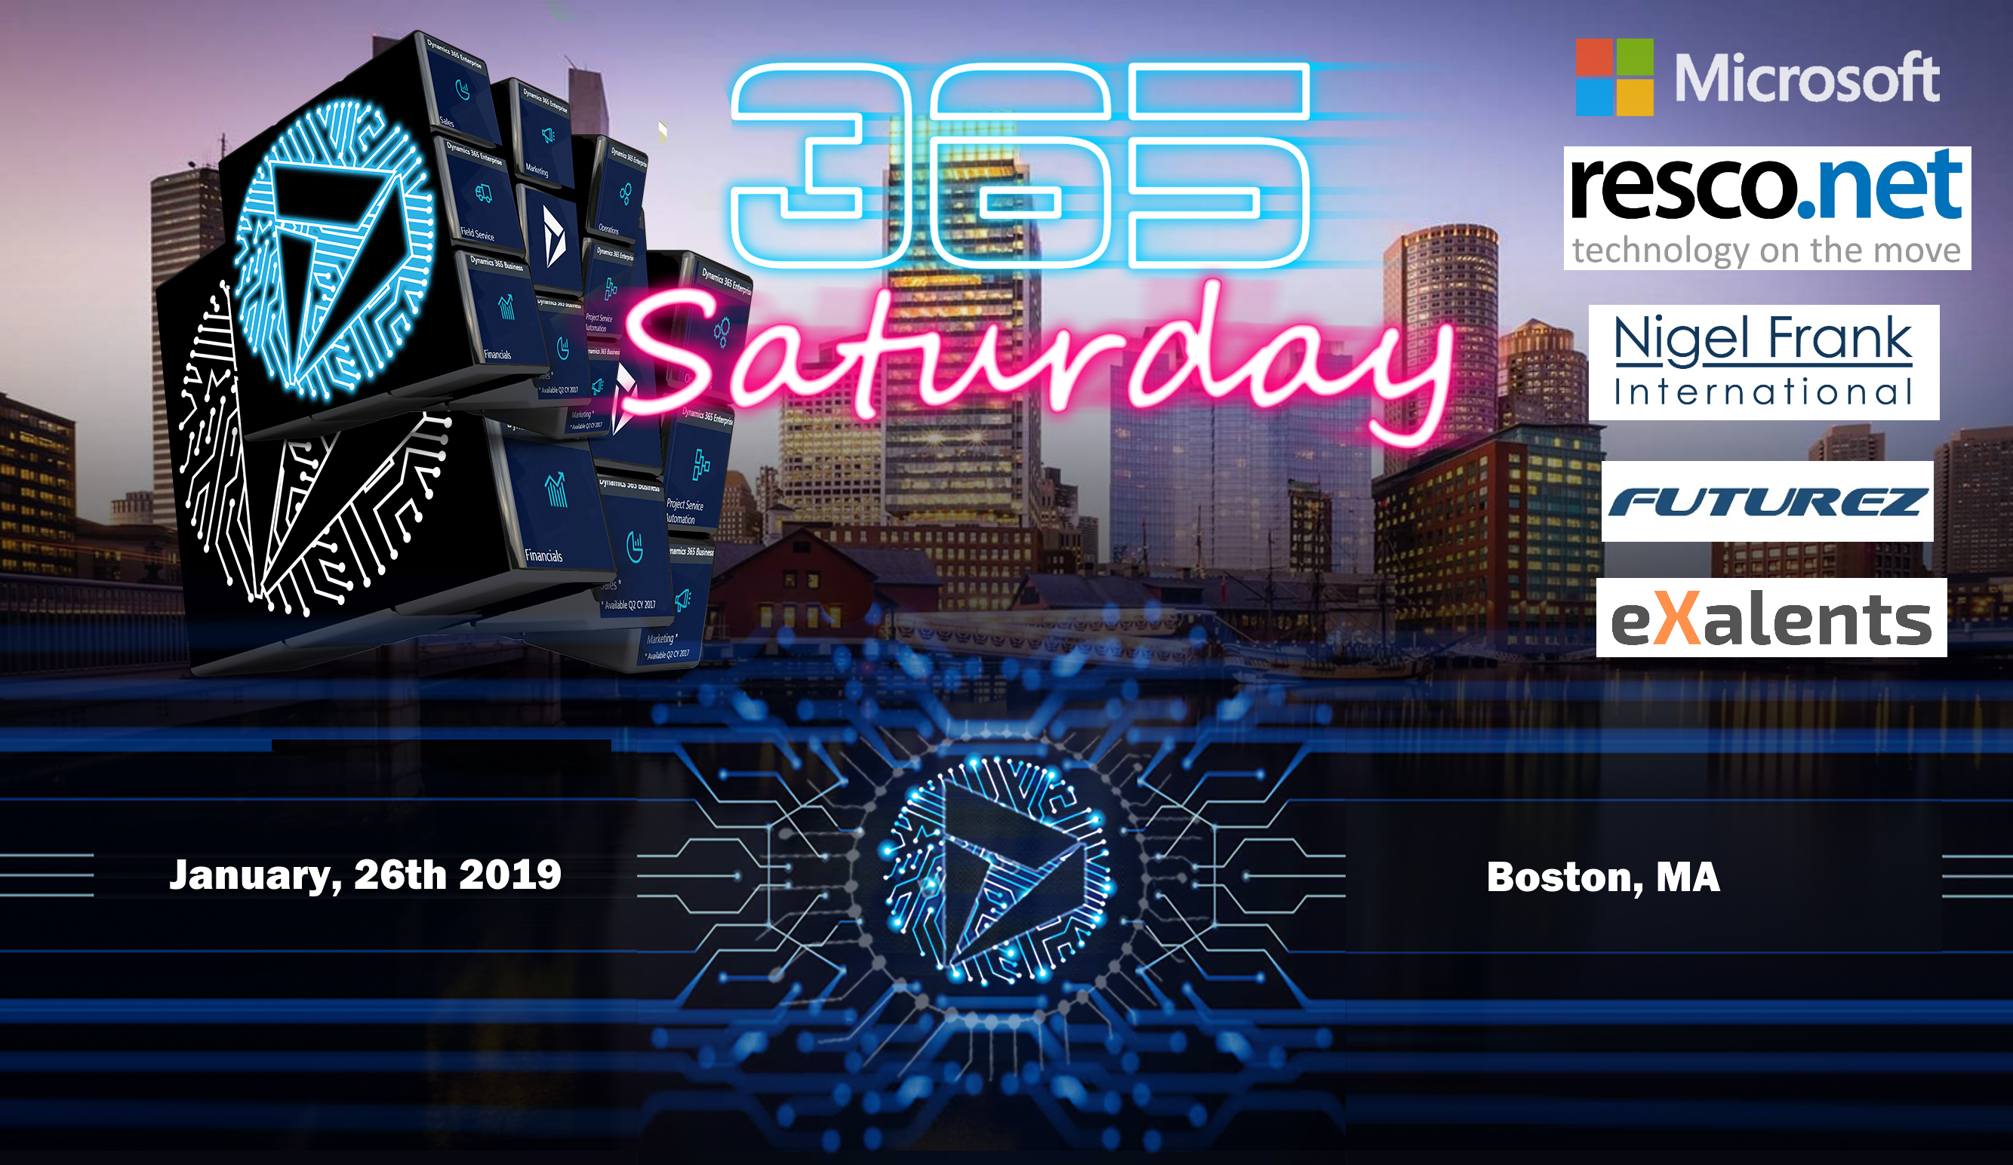

Slide 3


Slide 4

Agenda
What is LUIS and the Bot Framework?
Why should we build Bots for Dynamics 365?
How do we build Intelligent Dynamics 365 Bots? (Demo)
Questions & Discussion

Slide 5
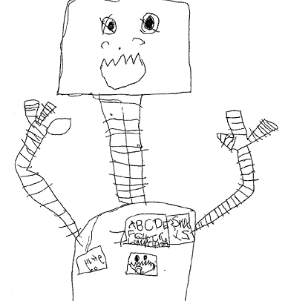
What is a Bot?
“A computer program designed to simulate conversation with human users, especially over the Internet.” - Google
“A computer program designed to act as an augmented command line interface over the internet.” – Dynamics Developer

Slide 6
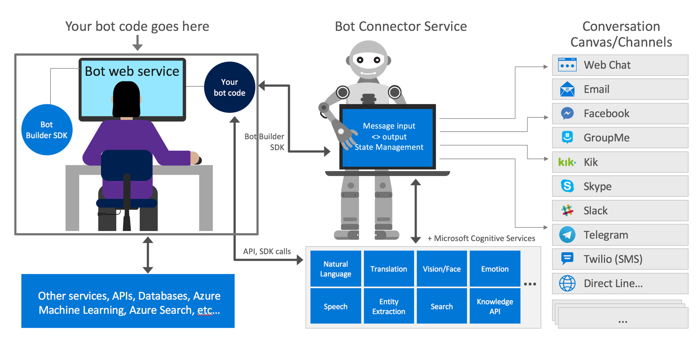
Bot Framework Architecture

Slide 7
Demo

Slide 8
Resources
Bot Service Walkthrough: https://docs.microsoft.com/en-us/azure/bot-service/bot-service-quickstart
Bot Framework Emulator: https://github.com/Microsoft/BotFramework-Emulator/releases
D365 Sample Bot: https://github.com/MikeFactorial/Dyn365SampleBot
D365 Bot: https://github.com/MikeFactorial/CRMBot
LUIS: https://www.luis.ai/

Slide 9

Thank You!
Mike
Email: michael.ochs@exalents.com
Twitter: @mikefactorial
Aiden
Email: aiden.kaskela@exalents.com
Twitter: @AidenKaskela

